Slide 1
PC² Web Team Interface
Project Overview by
Josie Isaacson, Ethan Holman, Andrew Combs, and Dani Frodge

Slide 2
Introduction
What is PC²?
Programming Contest Control System
What was the motivation for building WTI?
Current system requires individual installation on all team computers
Notes:
PC^2: Programming Contest Control System developed at California State University. Used for ACM Regional and International Collegiate Programming Contests. Motivation: Current System requires individual installation on all team computers
This application can be run on a single computer and then accessed via browser by each team. Reducing the time needed in set up.

Slide 3
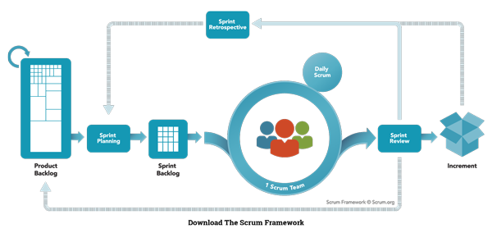
Project Management - Scrum

Slide 4
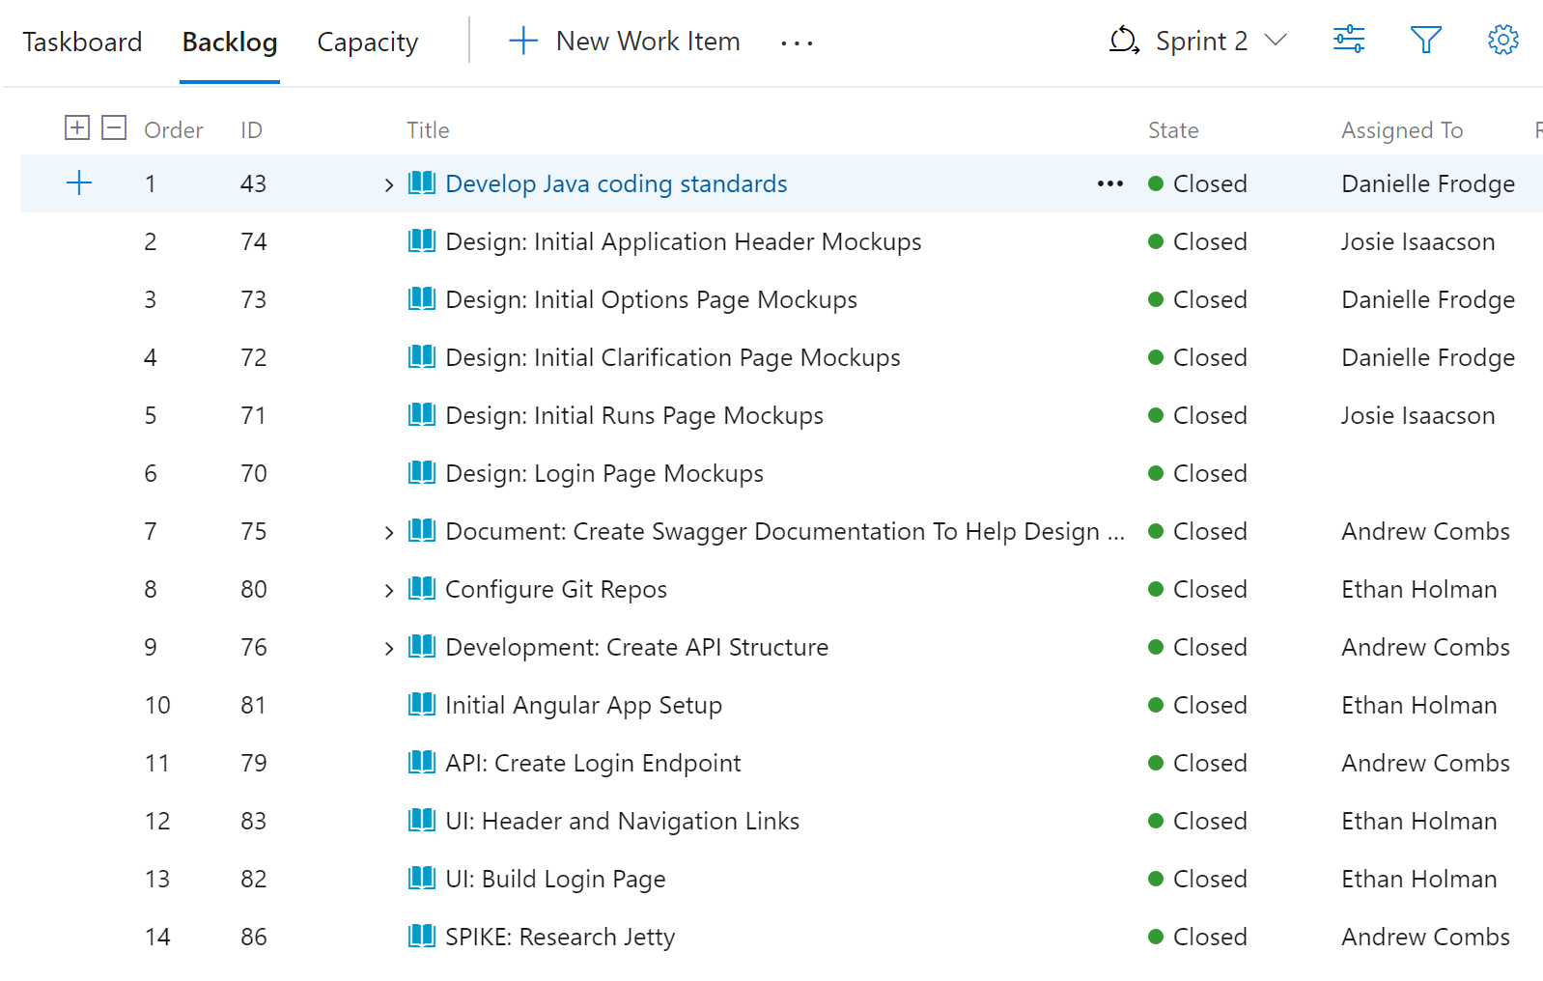
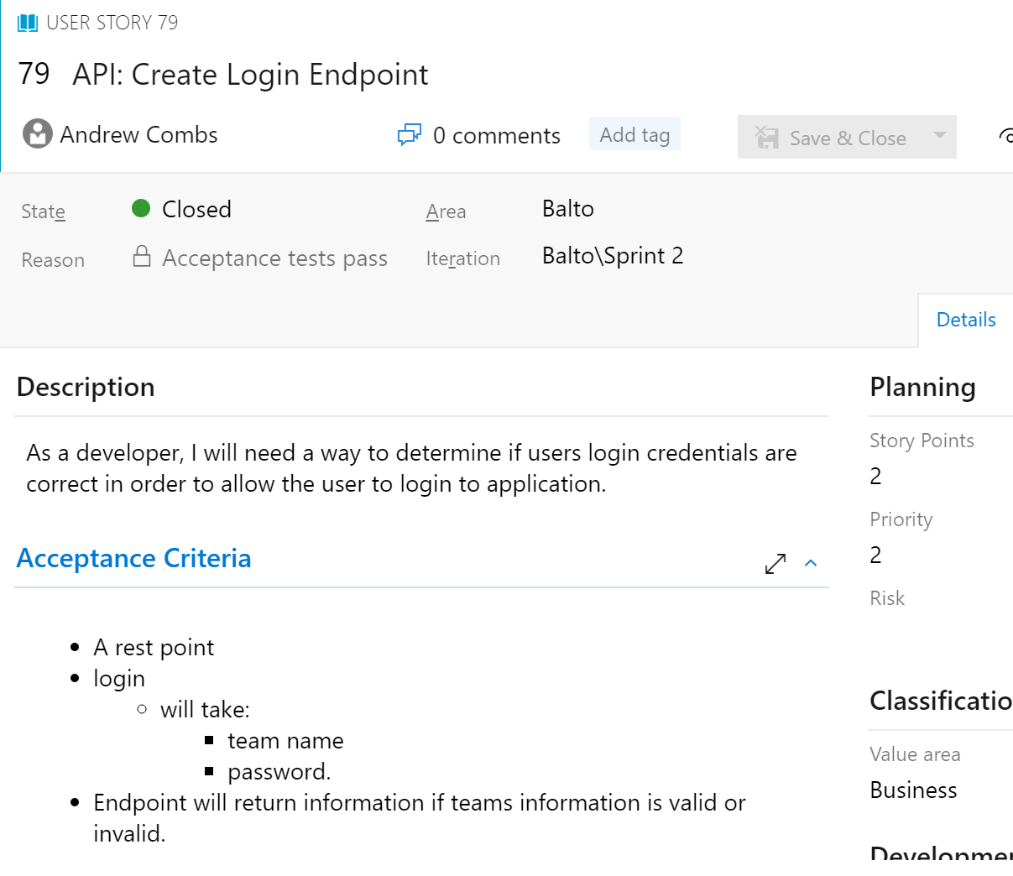
Project Management - DevOps

Slide 5
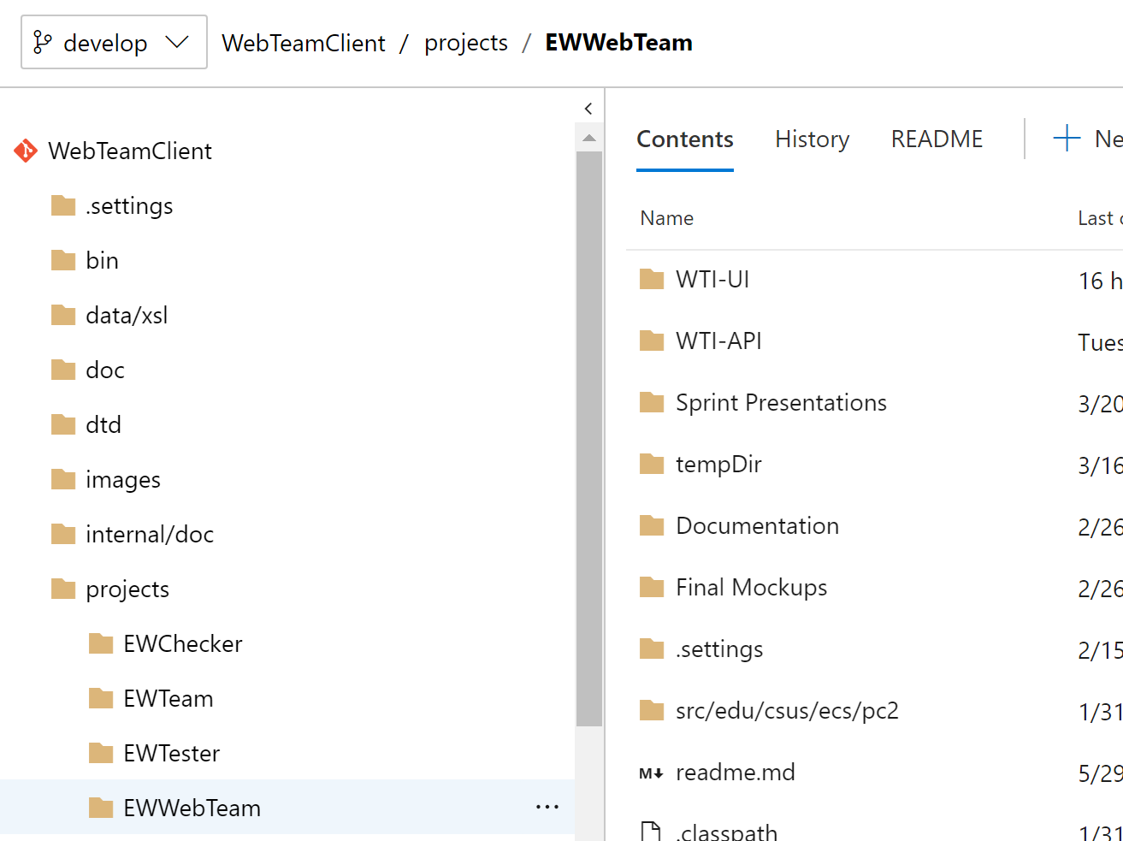
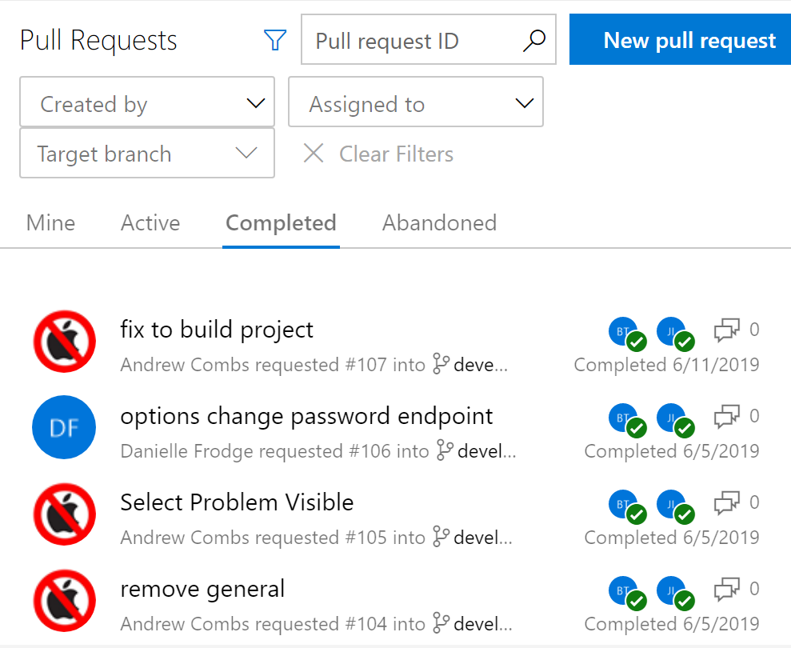
Project Management - DevOps

Slide 6
Architecture Overview

Slide 7
Project Architecture
Web Team Interface project is composed of two separate applications:
WTI-UI: Frontend
WTI-API: Backend (API)
Motivations:
Decouple UI from backend -- future UI can reuse same backend
Utilize a modern framework for building UI
Notes:
WTI-UI: that’s the front-end, what people see
WTI-API: which is the backend, what manages the data and team connections behind the scenes
So, the motivations for this separation:
It’s good design! If the UI is decoupled from the backend, it allows UI’s to be interchanged with each other! They can all reuse the same backend
It’s also not possible to use a modern UI framework served directly from a java backend

Slide 8
Project Architecture
UI communicates with backend via REST API and websockets
REST endpoints yield data about contest
Websockets used to push notifications/messages from backend to UI
Notes:
So how do the UI and backend communicate? Glad you asked…
The UI submits and receives data via HTTP calls to the REST endpoints running in WTI-API
A websocket is employed to allow WTI-API to contact the UI for contest updates, like clarifications, runs, etc.
The websocket was necessary because of one of the requirements for the project: that the UI doesn’t constantly pull for new notifications.
For example: When a clarification is answered, the API will send a message over the websocket alerting the UI. Each message includes an ID to identify the clarification that has been answered. Then, the UI will contact the REST API to get updated clarifications. Using the ID from the websocket, the UI can then display a notification for the updated clarification

Slide 9
Project Architecture
WTI-UI:
Web-based interface for PC² contests
Developed using the Angular Framework
Supports all modern browsers
Code follows the official Angular style guide
WTI-API:
Written in Java
MVC Architecture
Utilizes the following:
Jetty
Jersey
Jackson (JSON handling)
Jetty handles both API requests and UI
Notes:
Angular: Talk about what it is and how it works (JS, HTML, and CSS when compiled)
We’ll do a demo shortly that shows the UI in action.
WTI-UI is the actual interface that teams will see. It’s a web application that runs in your web browser.
Went with Angular to build it
All modern browsers are supported
Most older browsers should work fine too, as long as they are semi-recent (not like 5 years old or something!) (Just need to support flexbox, websockets, and of course, javascript)
Don’t try internet explorer, though! IE11 should work but not tested
As far as code goes, it follows the angular style guide and standard practices.
On the API side…
Written in java to interface easily with the existing PC2 legacy code
API endpoints use an MVC architecture, similar to that which ASP.NET provides out of the box
A web server is self contained. When the project is built, it will service not only API requests and websocket connections, but also serve up the UI
Allows for easy running of the project for a contest, because you only need to execute a single compiled .jar file.

Slide 10
Design and Demo

Slide 11
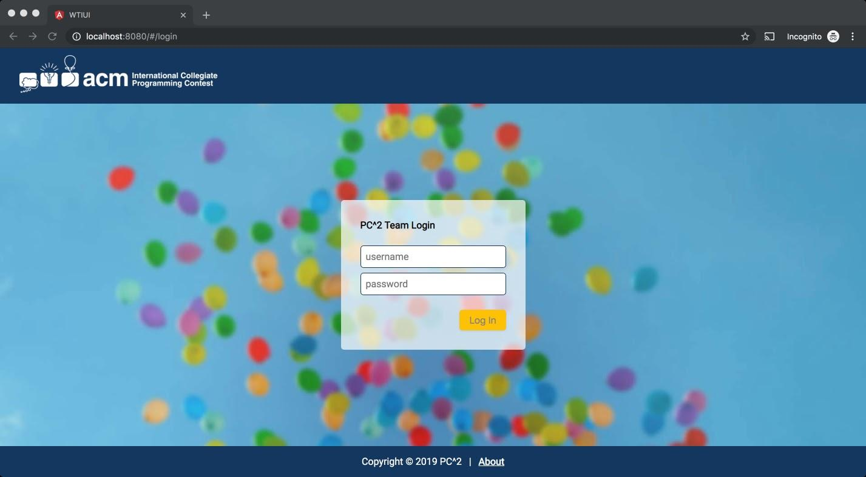
Login Design

Slide 12
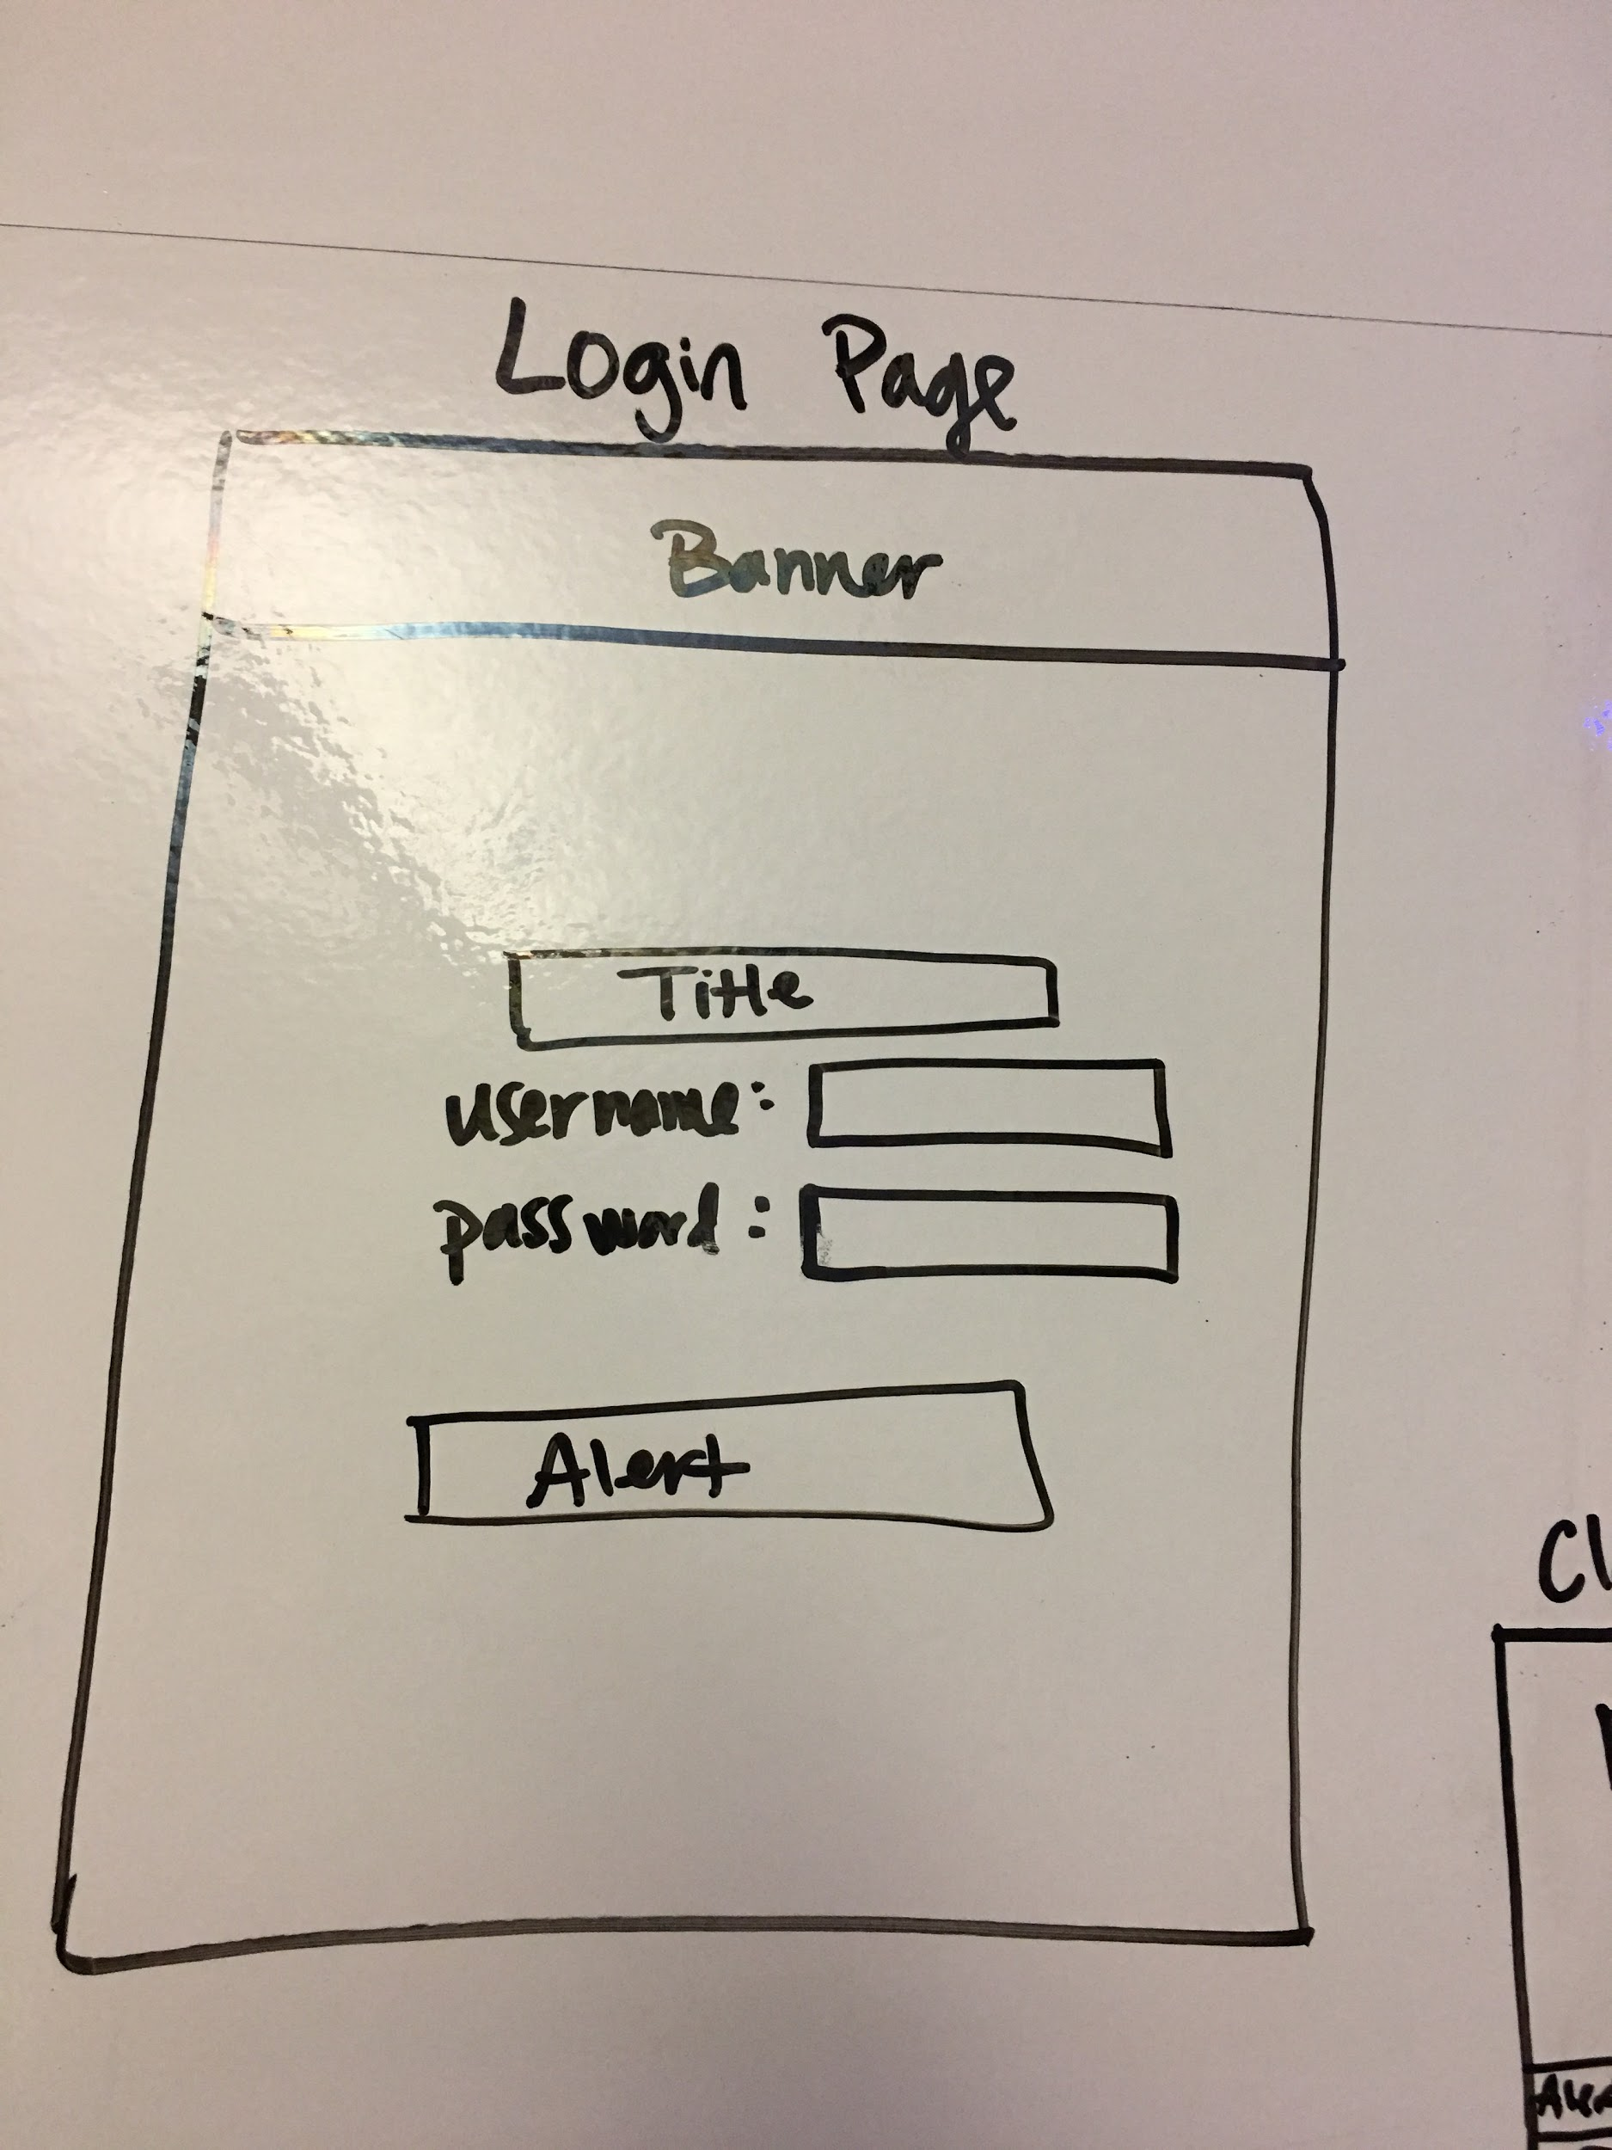
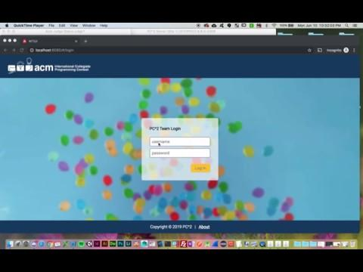
Login Demo

Slide 13
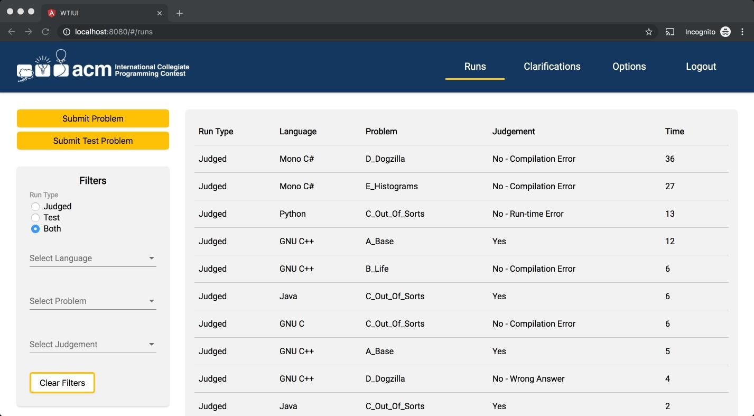
View Runs Design

Slide 14
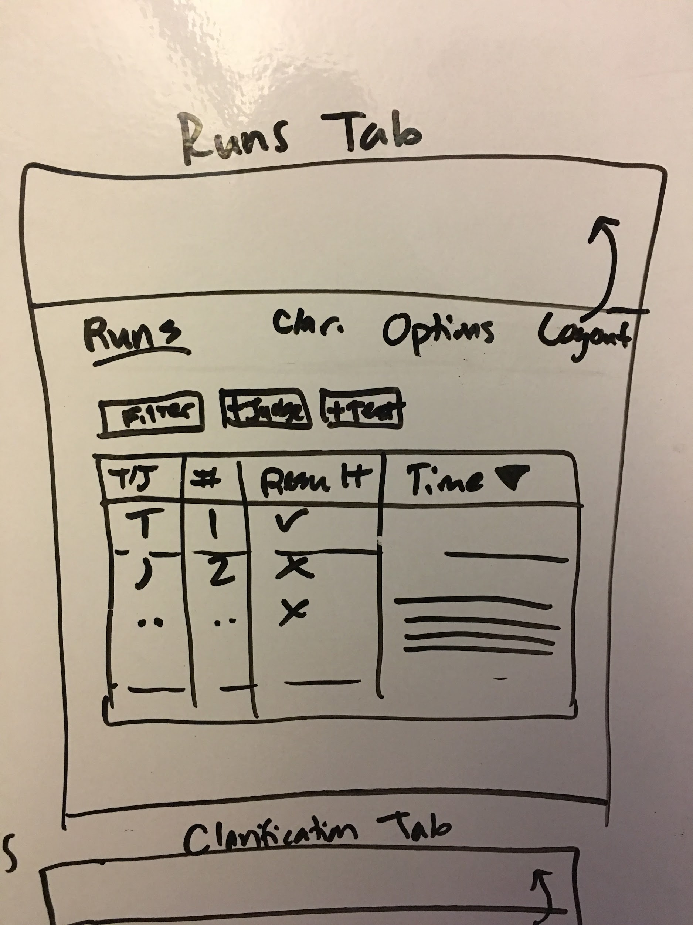
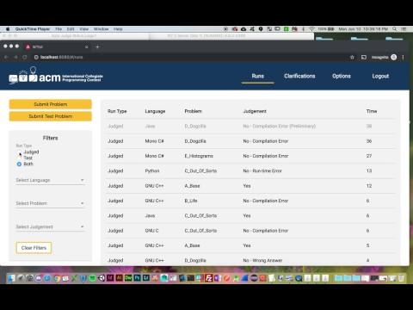
View Runs Demo

Slide 15
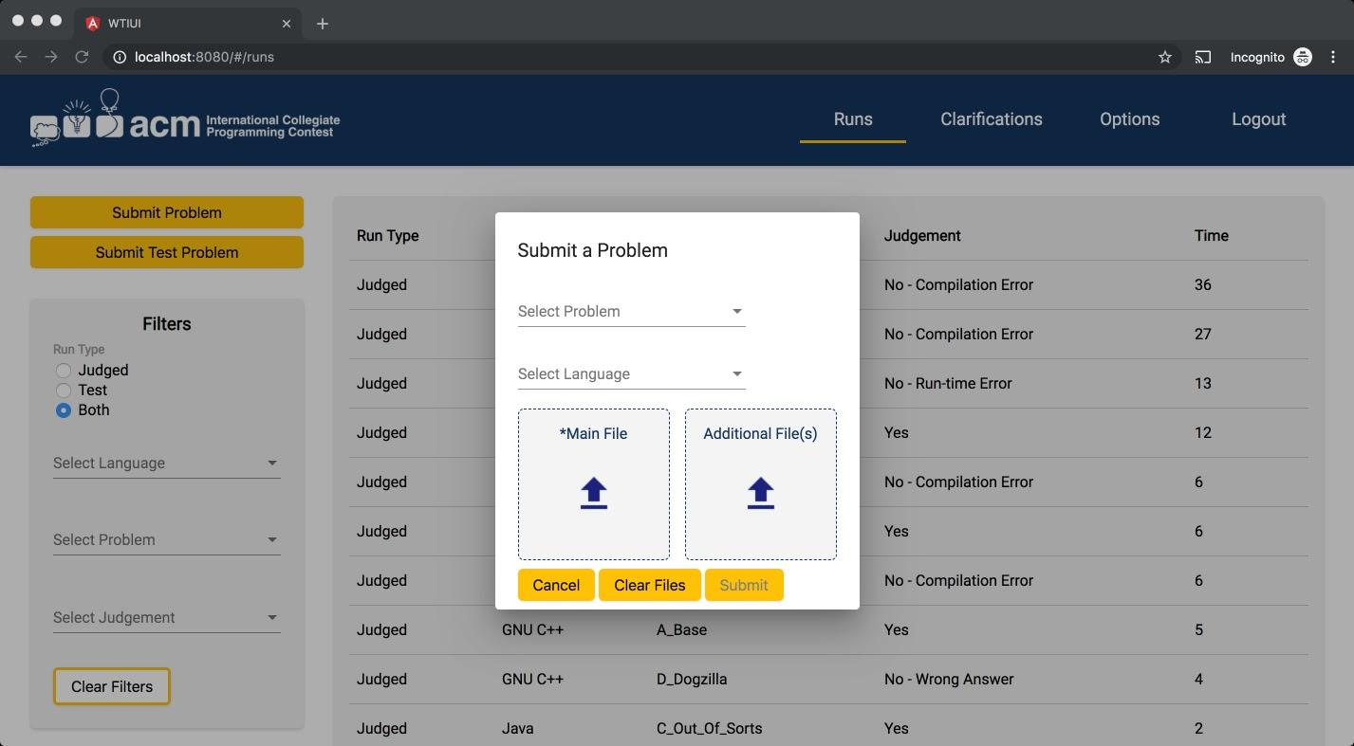
Submit Run Design

Slide 16
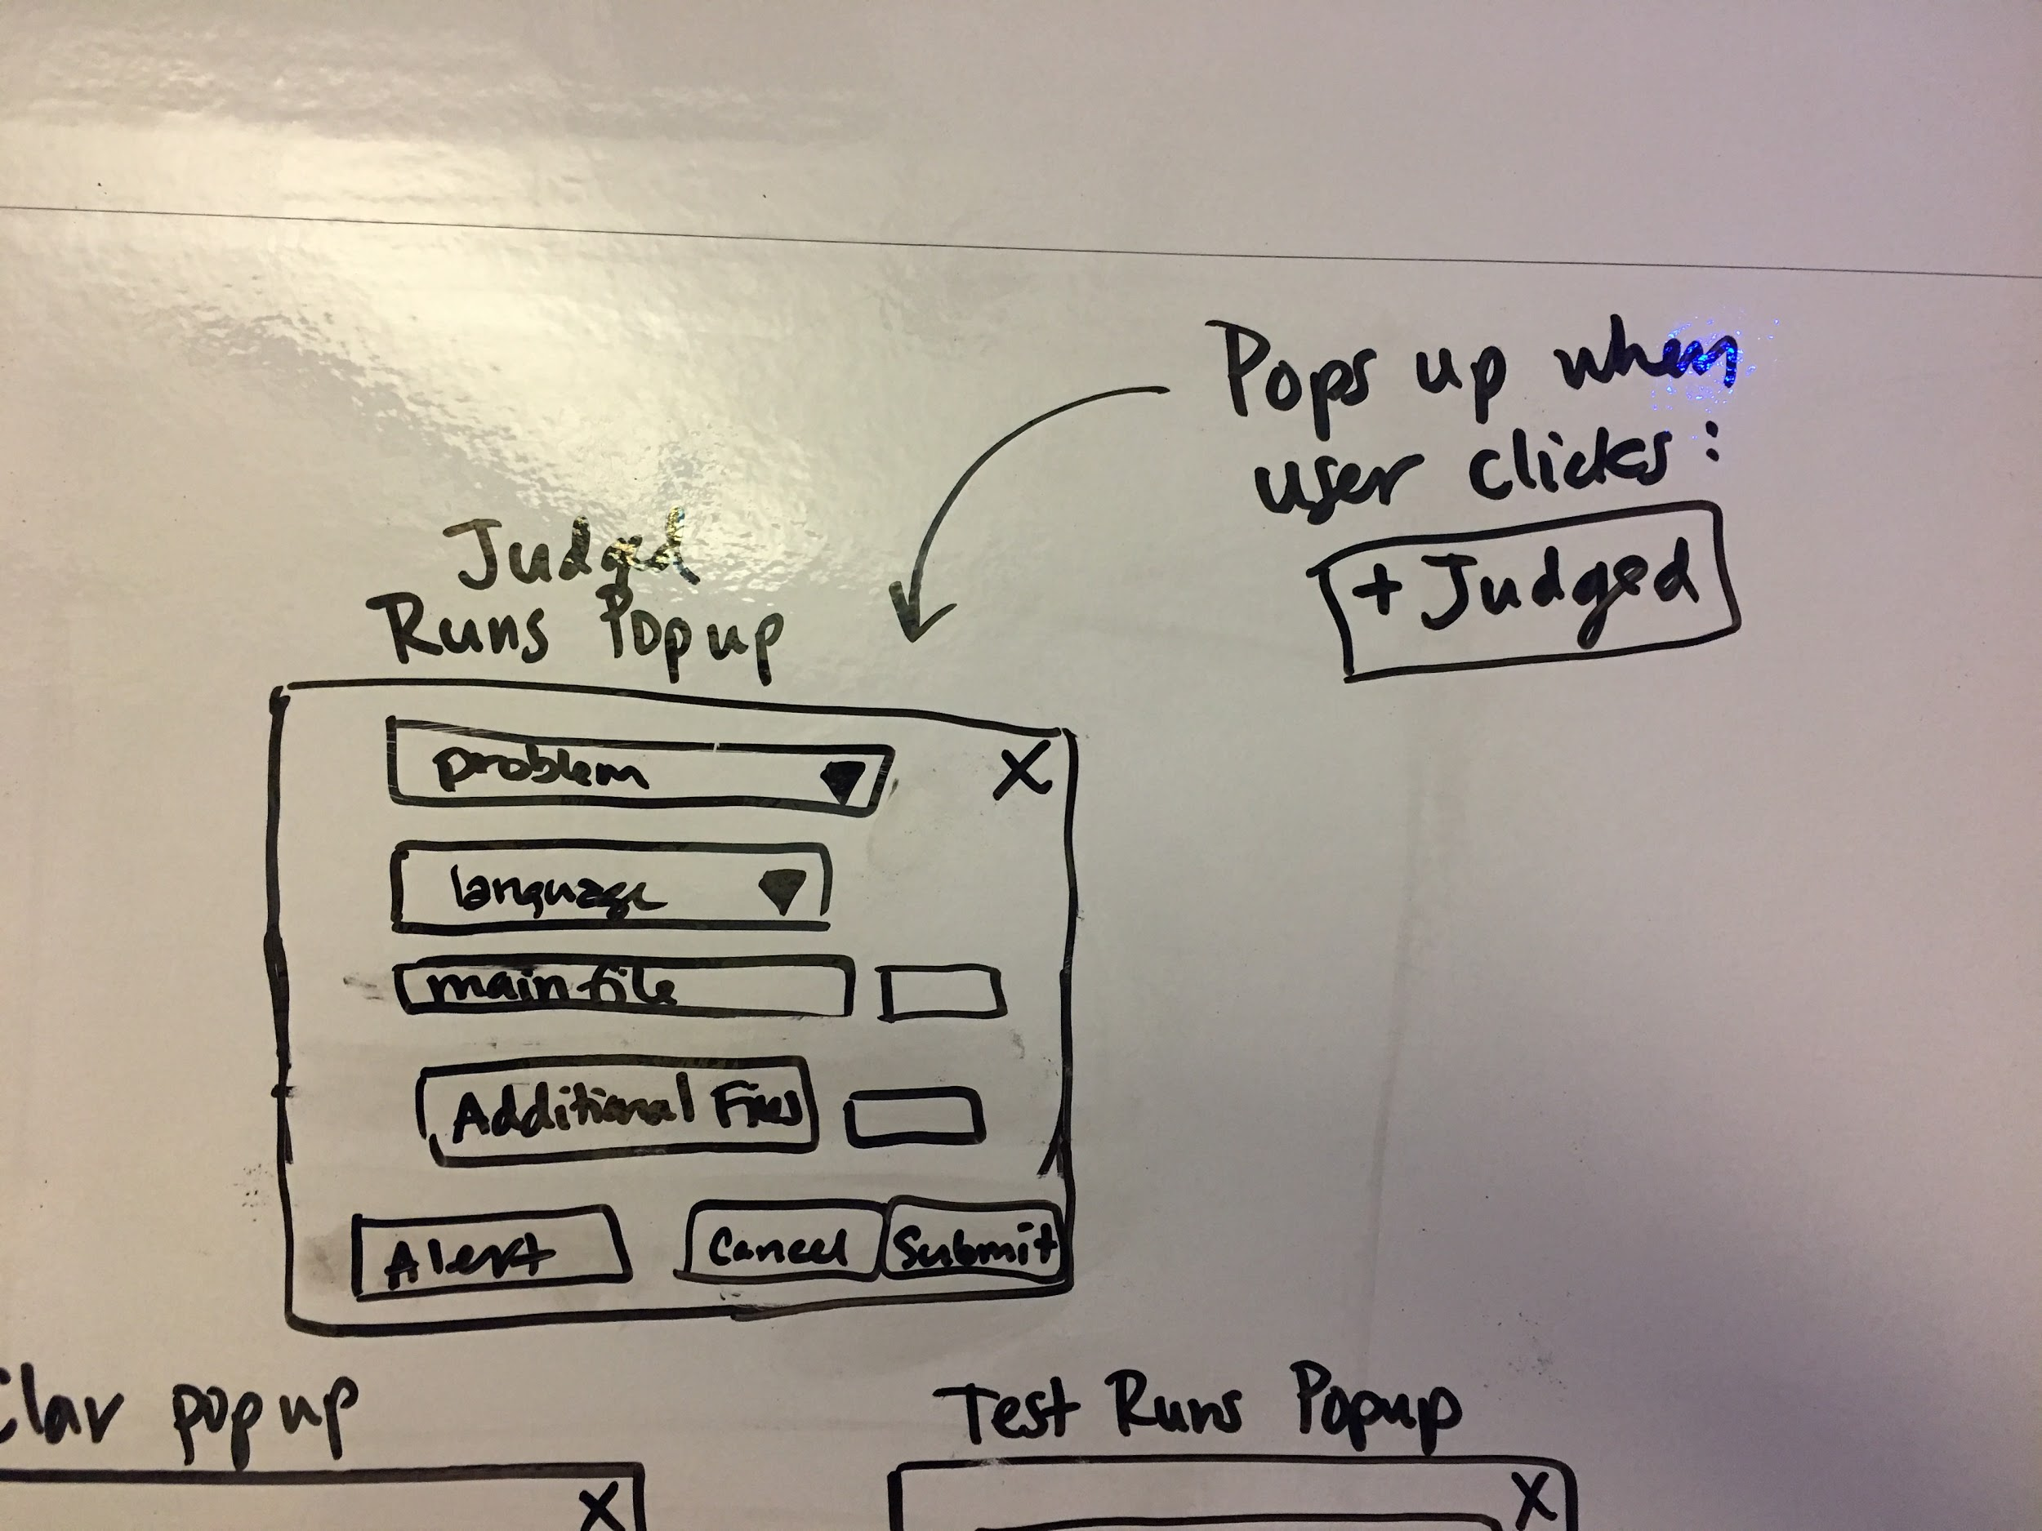
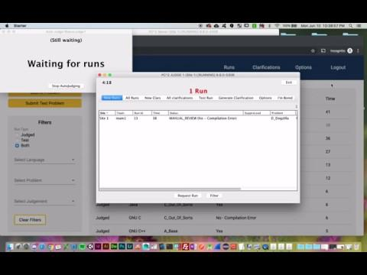
Submit Run Demo

Slide 17
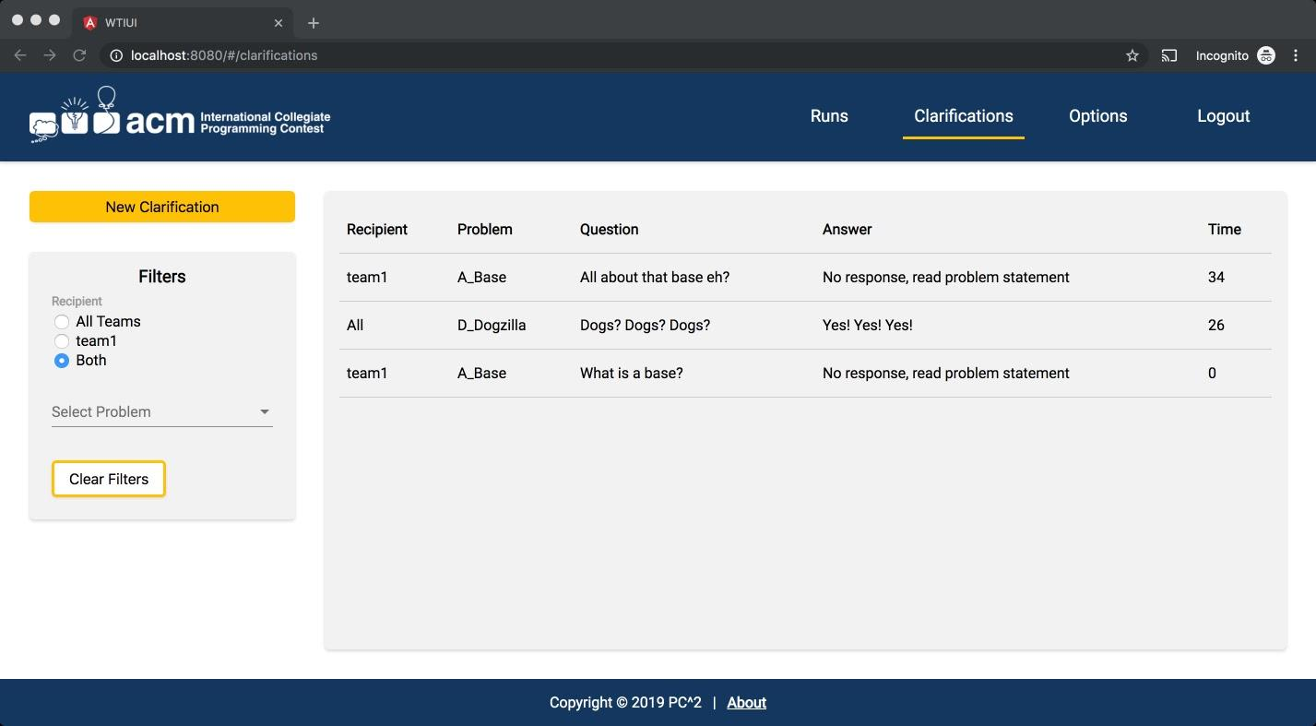
View Clarifications Design

Slide 18
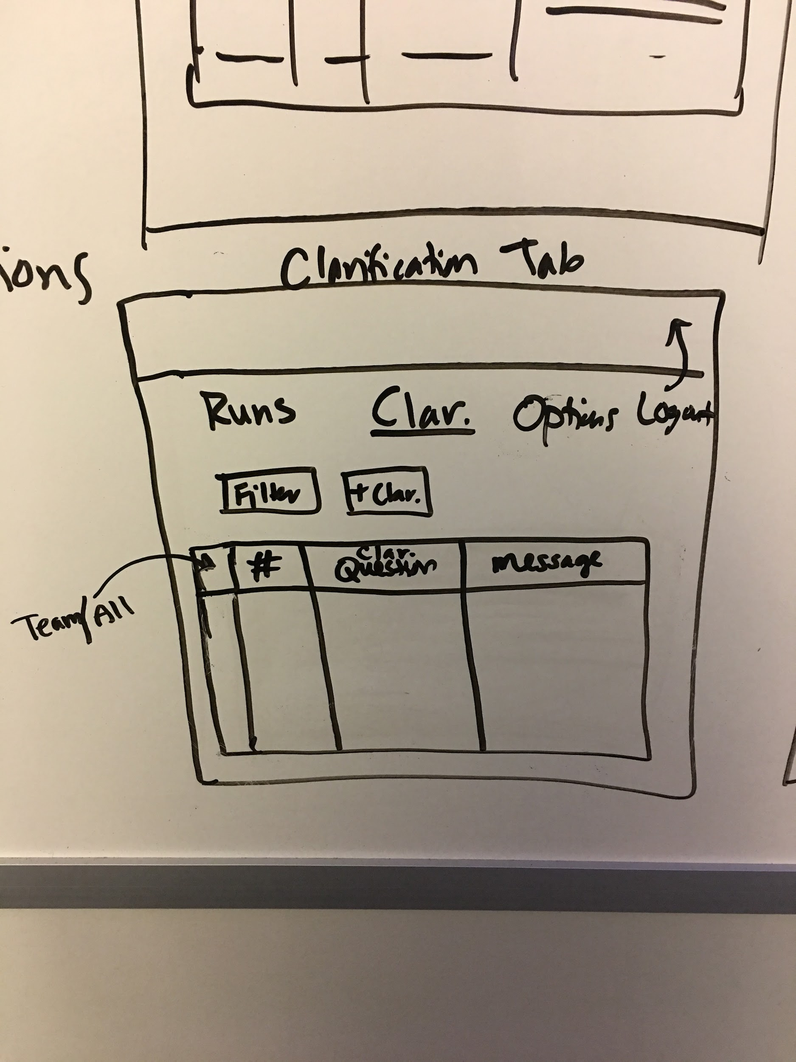

View Clarifications
Demo

Slide 19
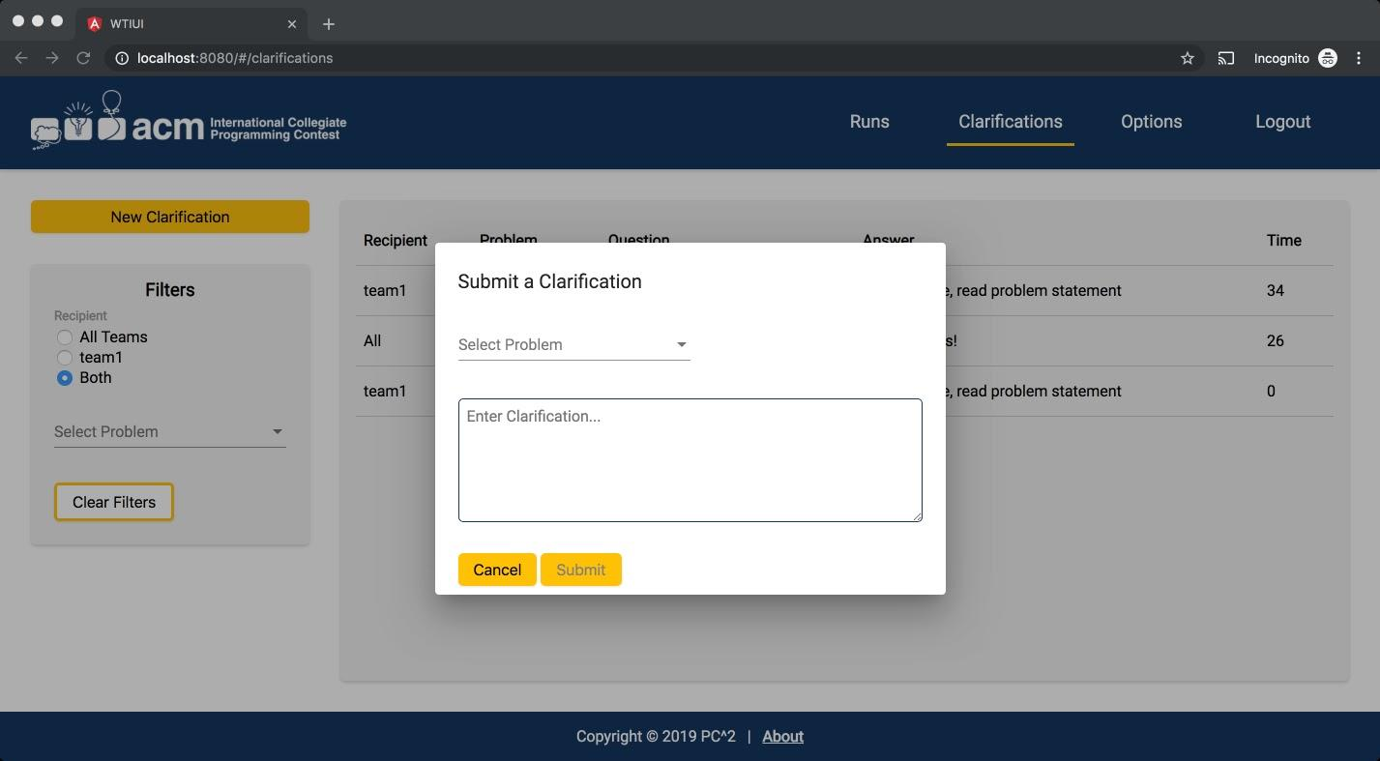
Submit Clarification Design

Slide 20
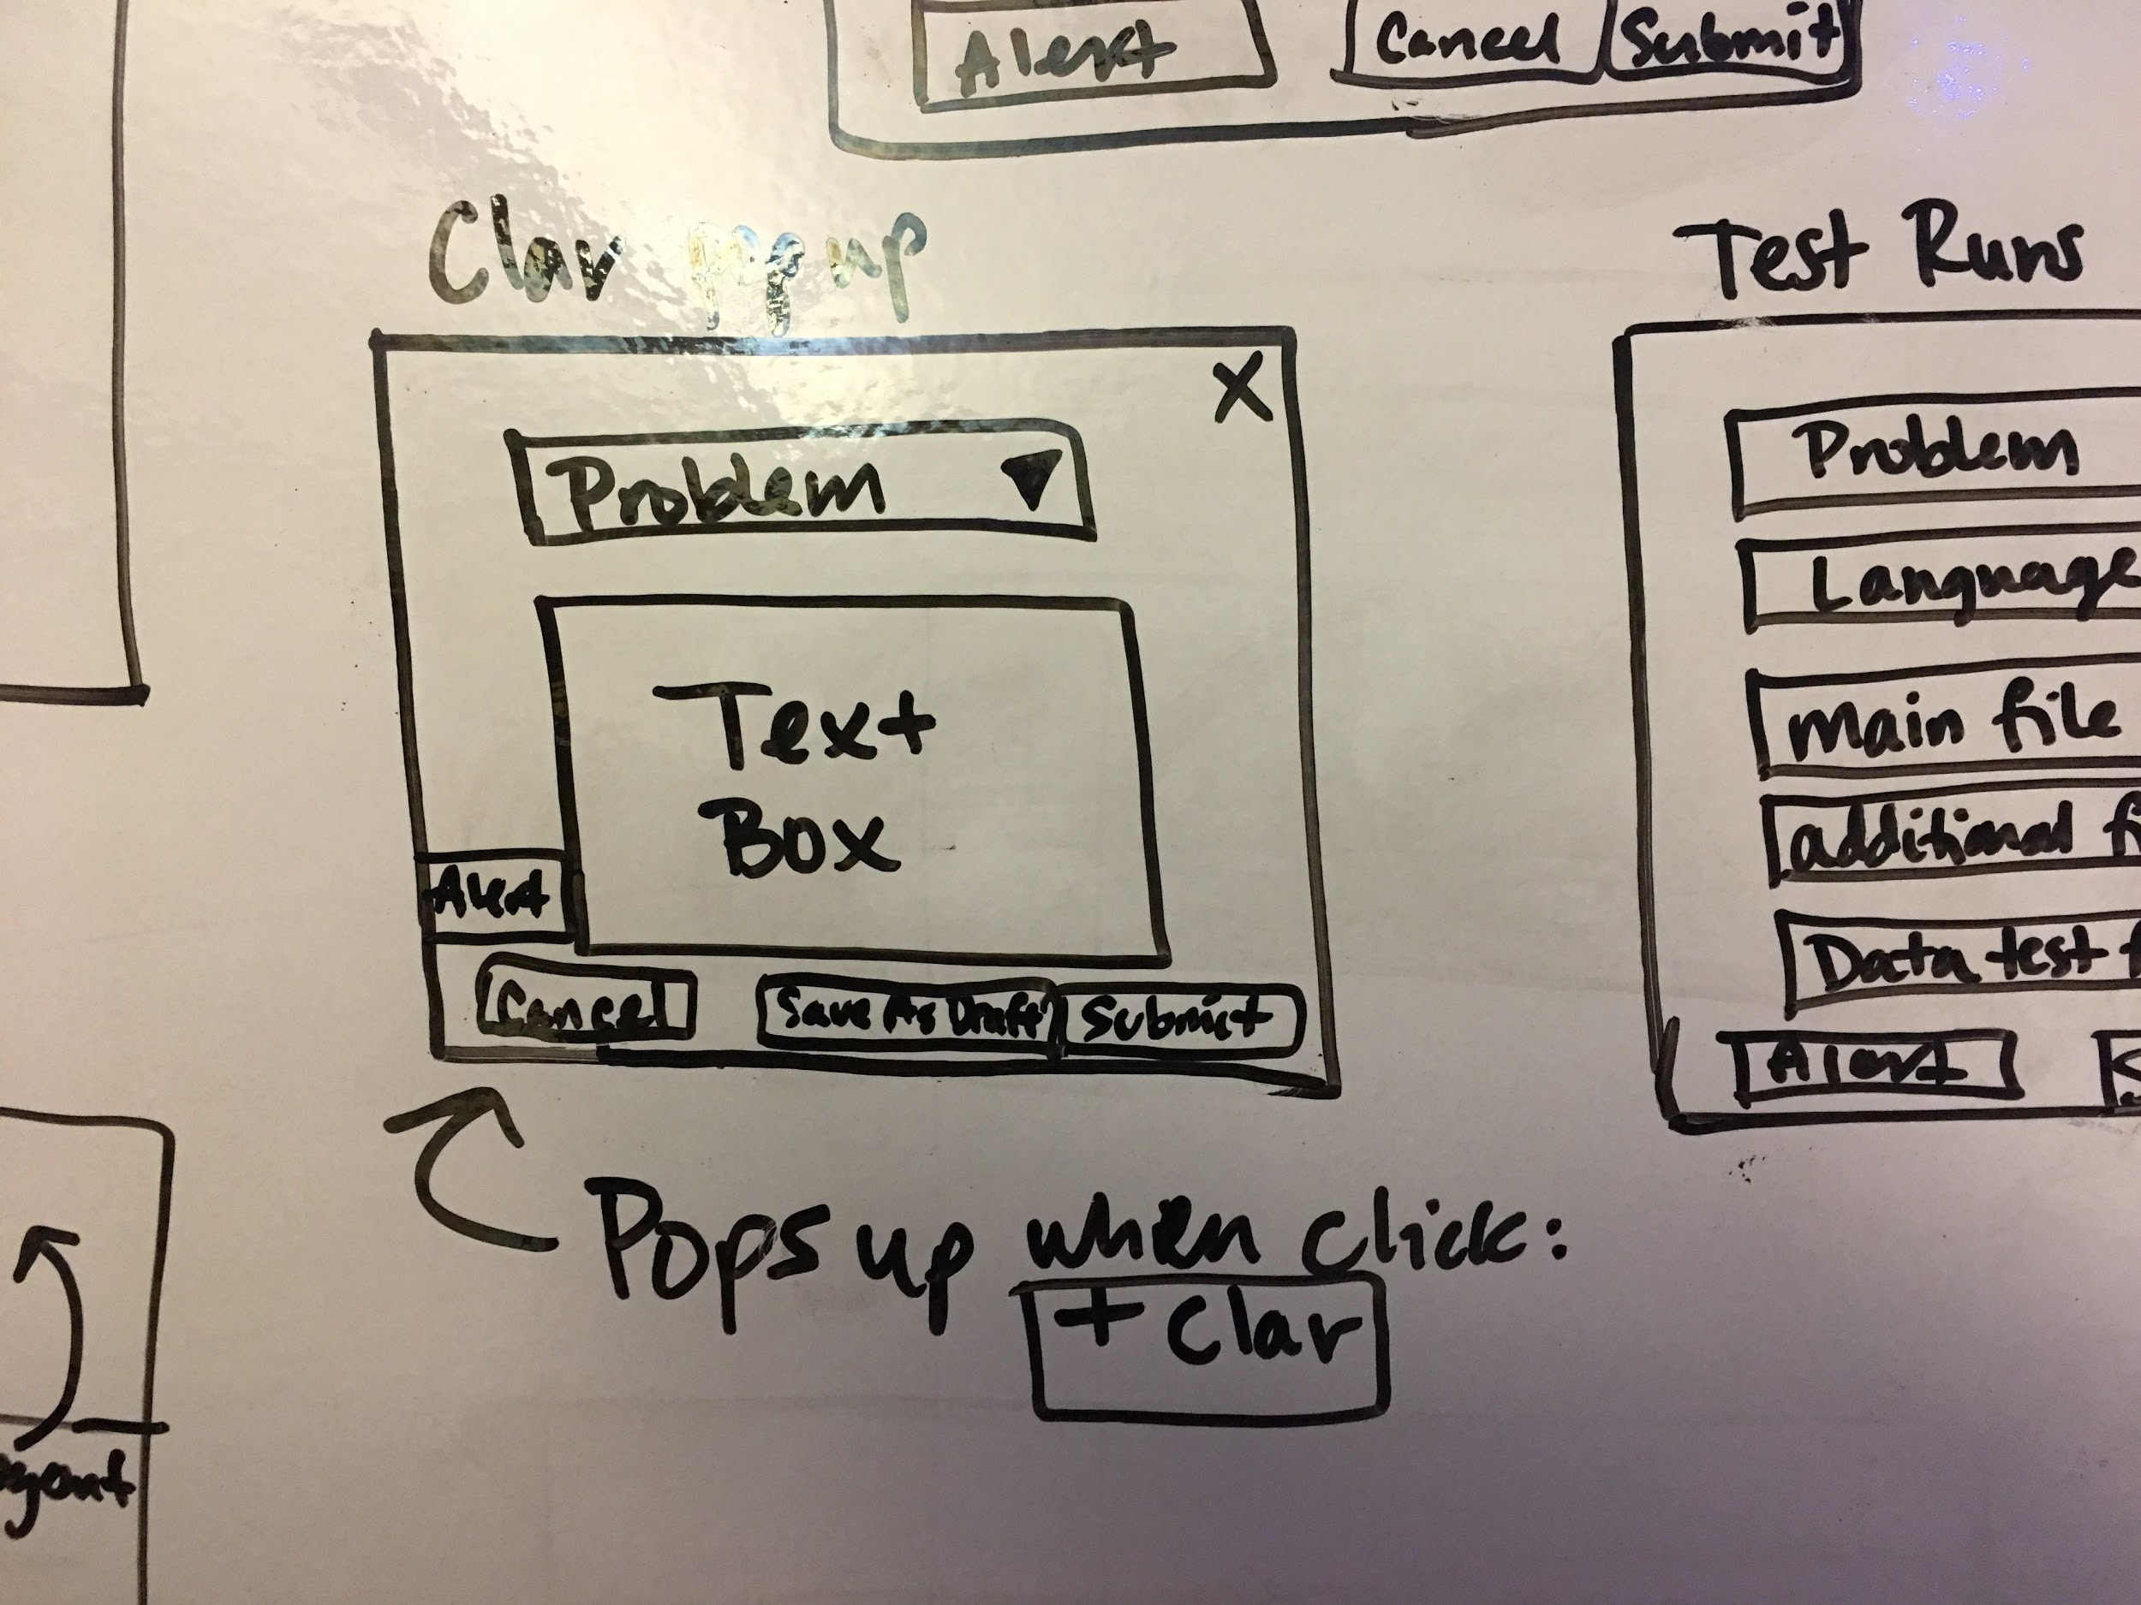
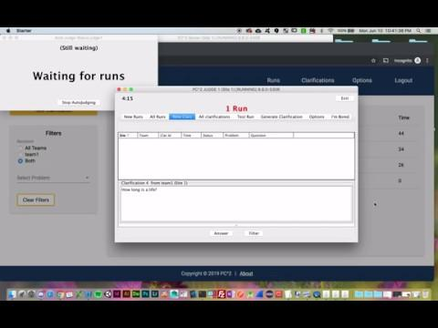
Submit
Clarification Demo

Slide 21
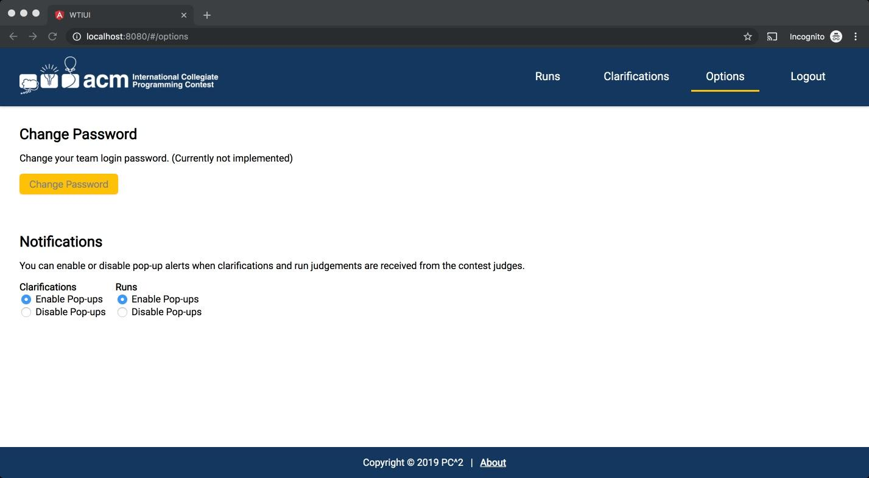
Options Design

Slide 22
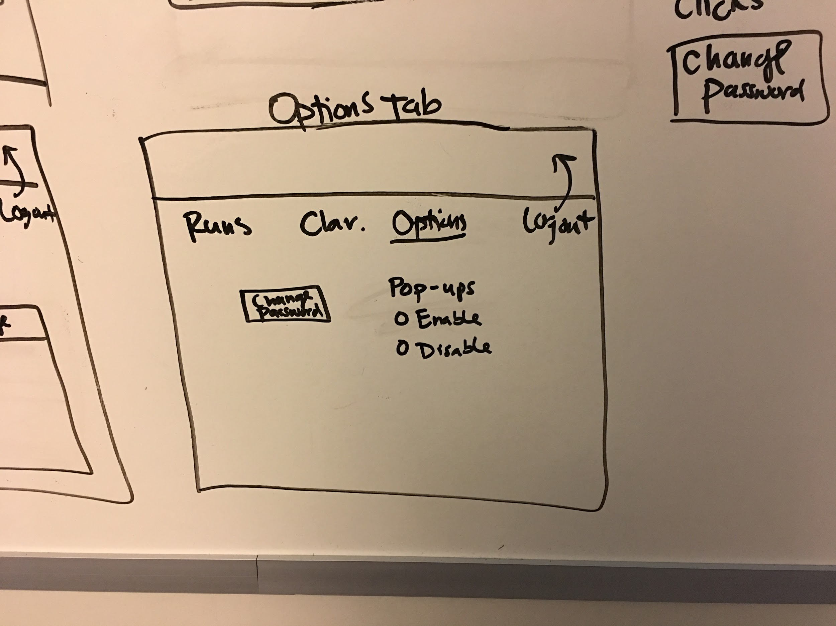
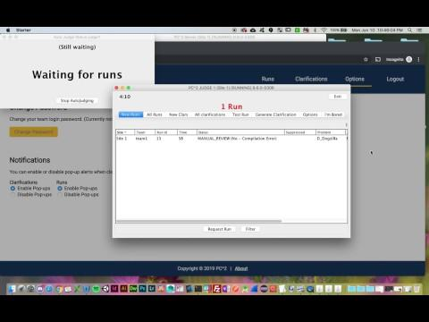
Options Demo

Slide 23
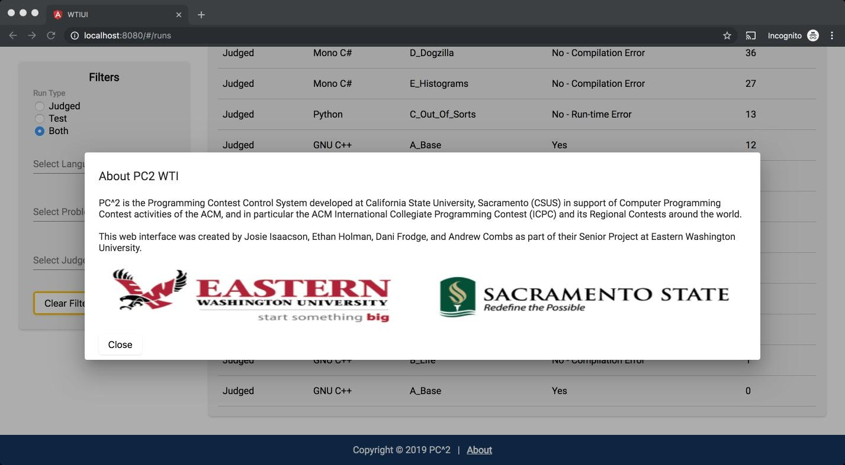
About Design

Slide 24
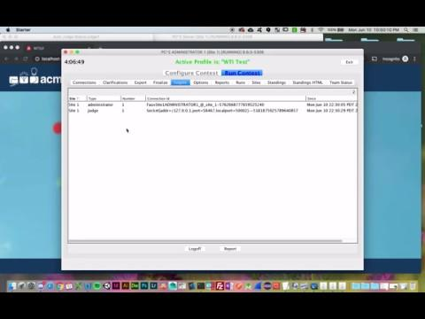
Logout Demo

Slide 25
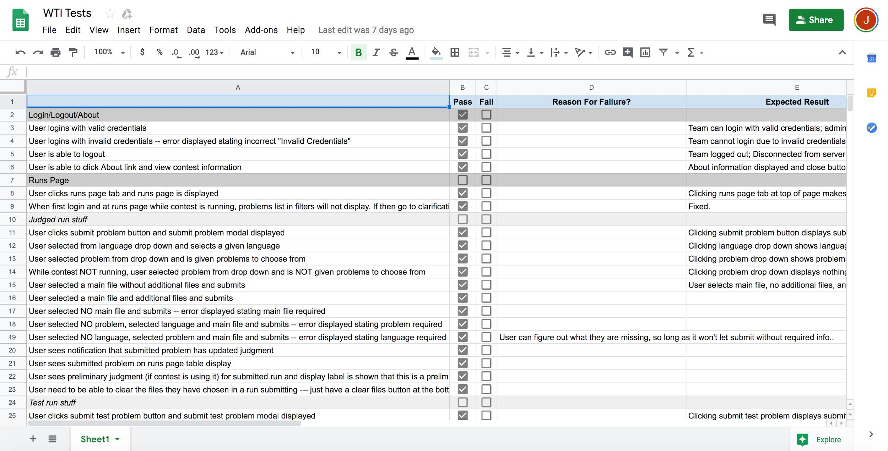
Testing Process
Test Description
Pass/Fail
Reason for failure
Expected Result
Actual Result
Testing Steps:
Configure and run a PC² contest.
Build and run WTI.
Test all scenarios while live contest is running.
64 testing
scenarios done

Slide 26
Shortcomings, Future Fixes,
& Things We Learned

Slide 27
Retrospective
Shortcomings:
Drag & Drop
User session
Save Draft for Clarifications
Future Fixes:
Test Runs
Change Password

Slide 28
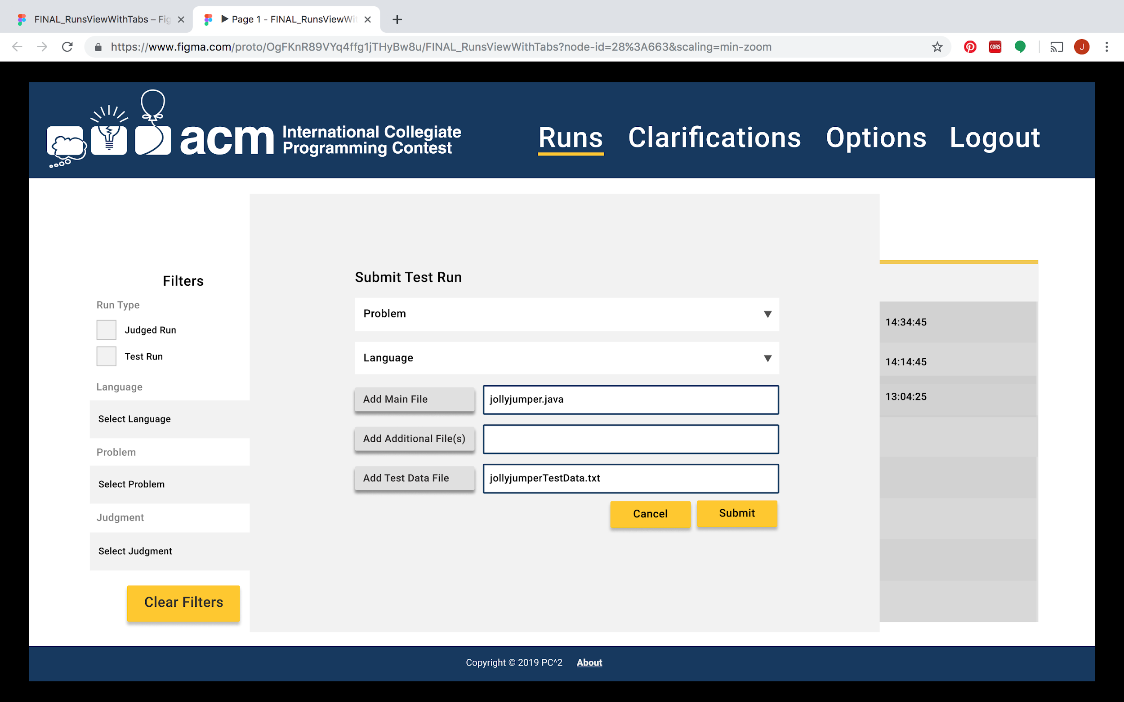
Submitting Runs Before and After

Slide 29
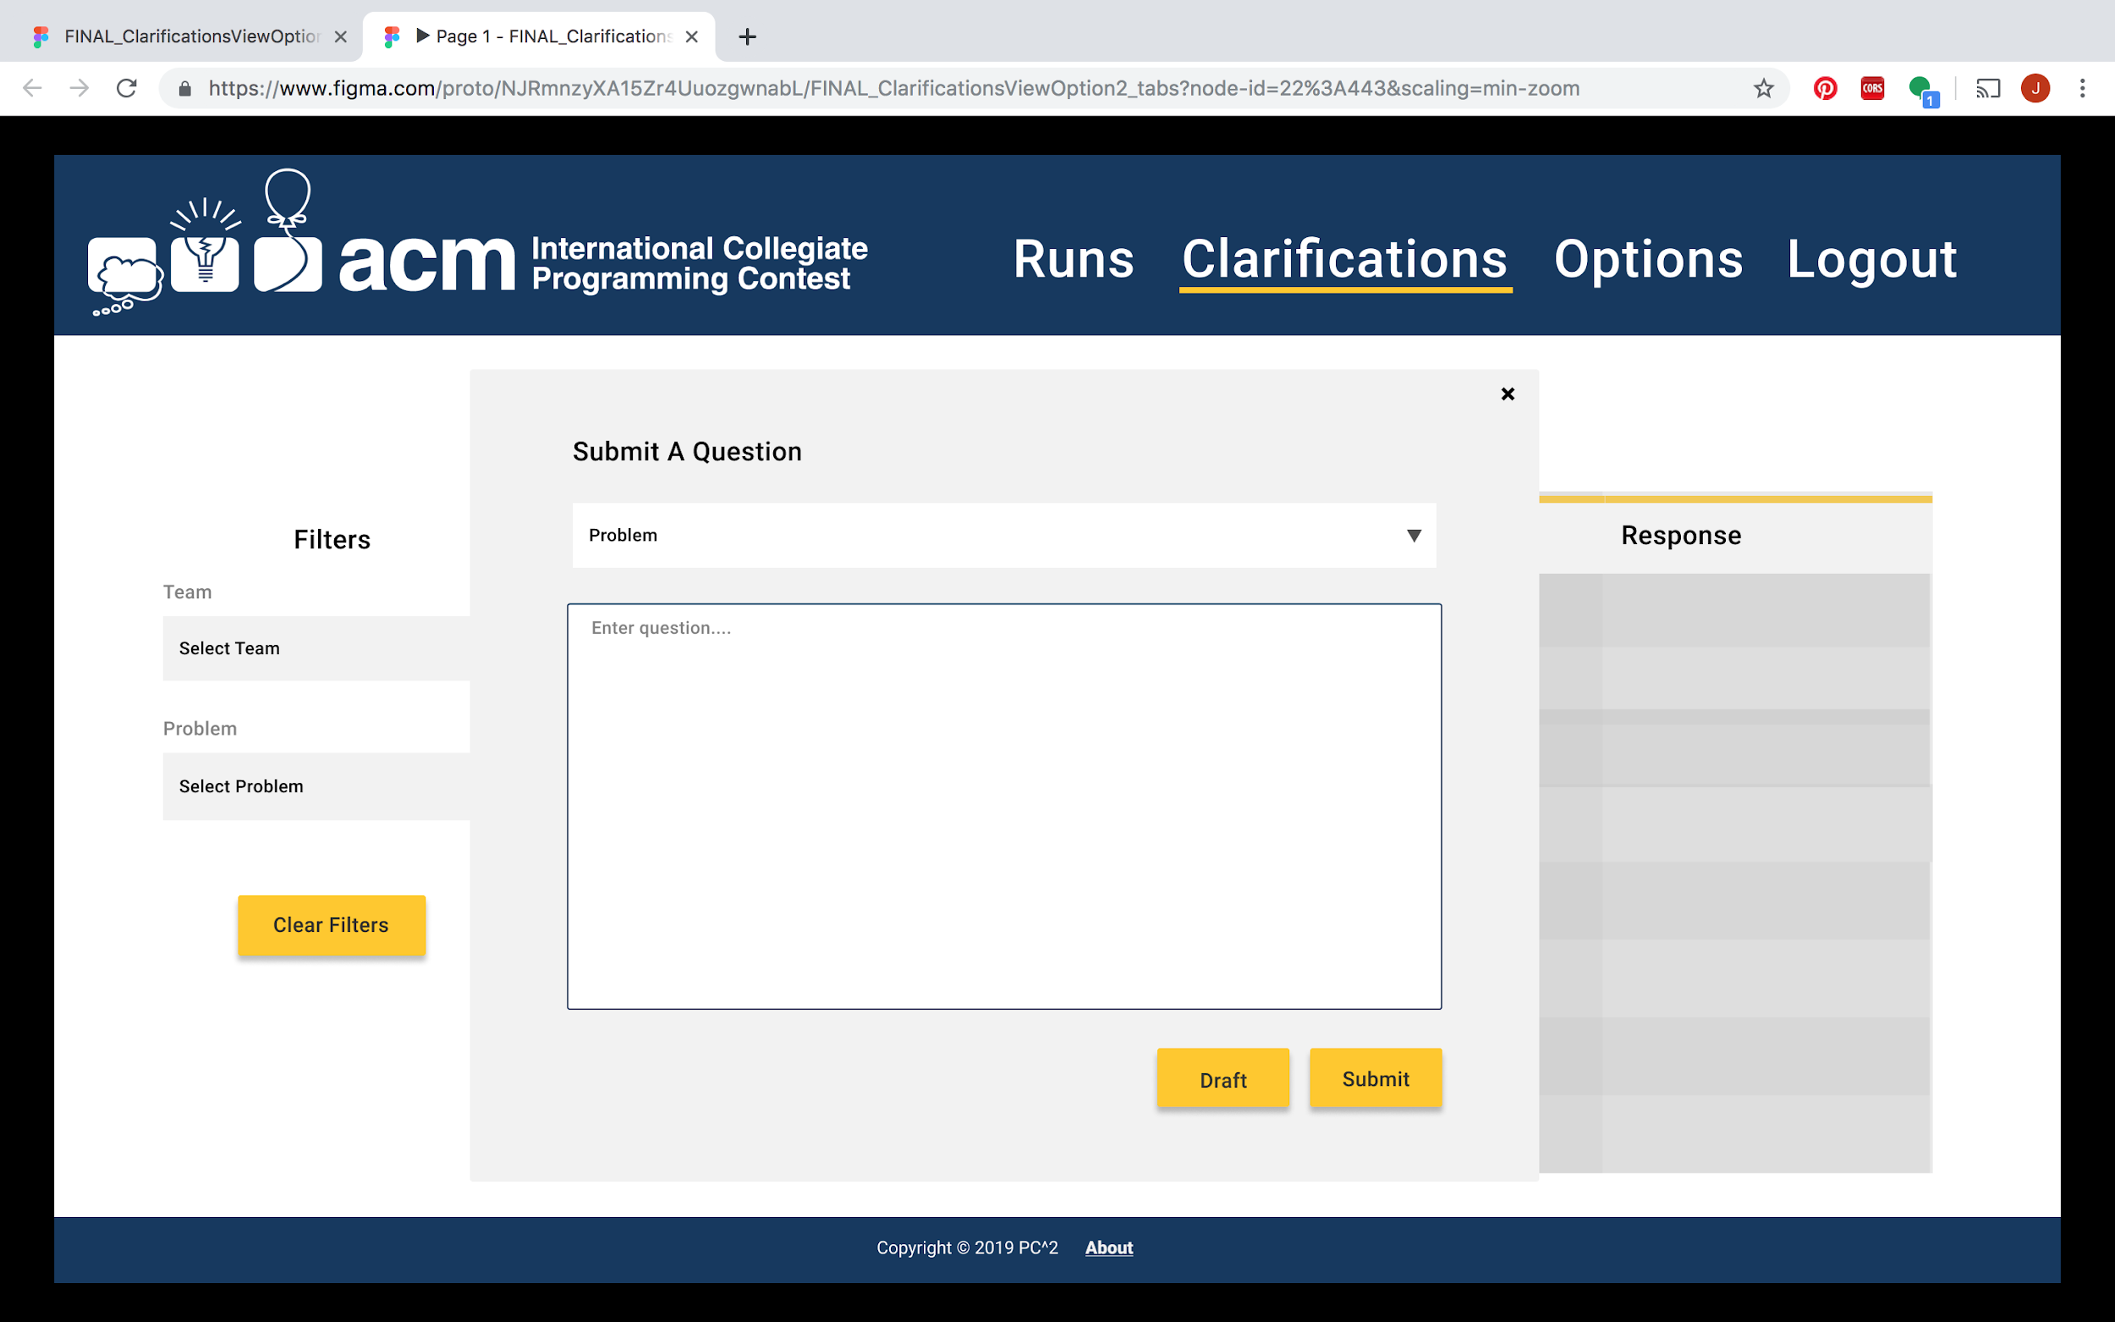
Clarifications

Slide 30
Things We Learned
New Skills / Methodologies Learned
Jersey
Working with legacy code (PC² system)
Swagger
Git Flow

Slide 31
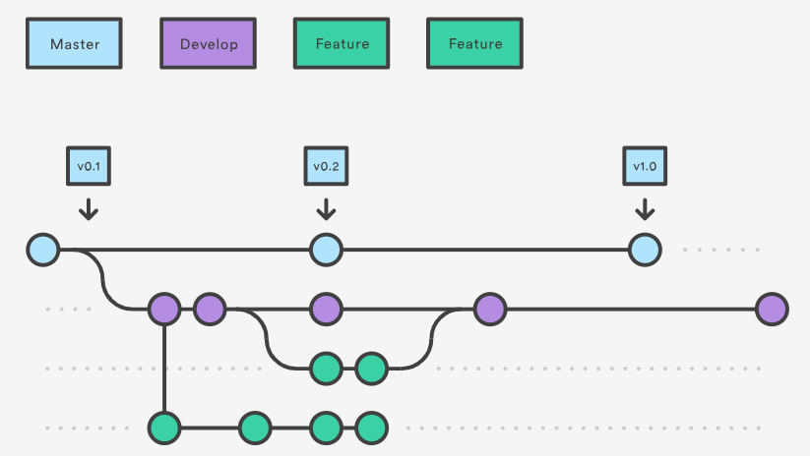
Git Flow

Slide 32
Questions?

